Slide 1
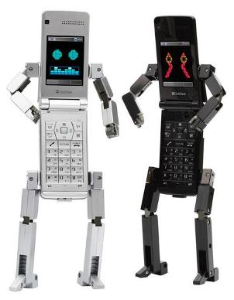



Context & Group Addressing
Jason Tam Scott Xu David Shen
http://summer.winlab.rutgers.edu/projects/wiki/2012/Projects/MobilityFirst/Context

Slide 2
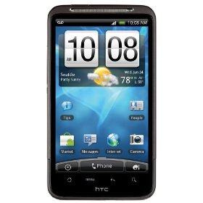
Purpose
Explore applications of group addressing and context aware messaging in the MobilityFirst framework
New branch of applications opened up
Group by sensor data context

Slide 3
Architecture

Slide 4
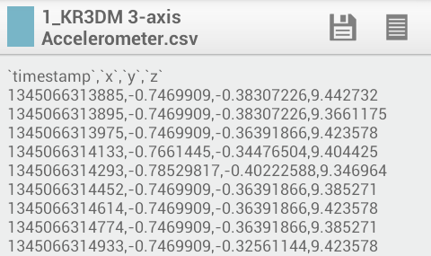
Data Server - PHP Query Construction
1_KR3DM 3-axis Accelerometer.csv
  Delimited by an underscore to determine
  table to insert into
`timestamp`,`x`,`y`,`z`
  Comma delimited field names for insertion
  field
1345066313885,-0.77469909,-0.3807226,9.442732
  Insertion values
[id, GUID, and ip added]
Final query to run
  INSERT INTO `1`(`timestamp`, `x`, `y`, `z`, `id`, `guid`, `ip`) VALUES (1345066313885, -0.77469909, -0.3807226, 9.442732, A000002241E787, 30B57BFBB820273207483858911A00377BD558A3, 174.226.197.69)

Slide 5
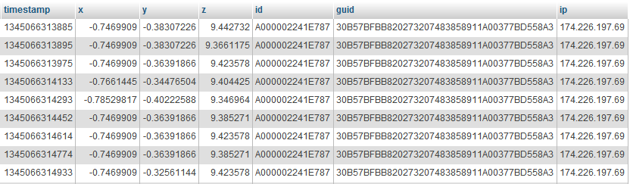
Data Server - MYSQL Contents

Slide 6
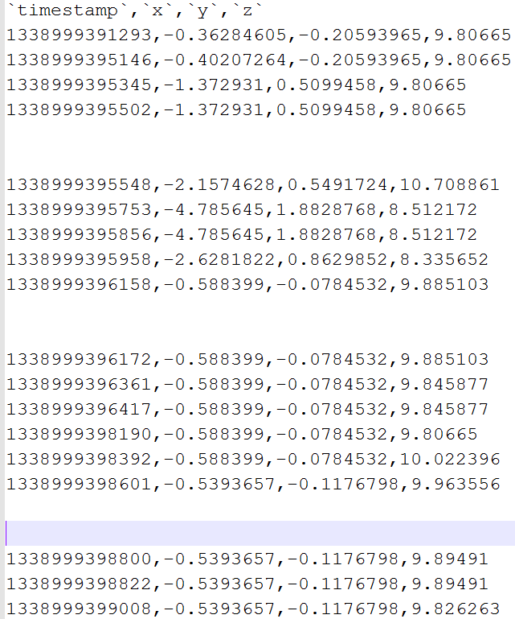
Robust Upload
Division of file into chunks
Grab last successfully uploaded timestamp
Timeout & increase wait time

Slide 7
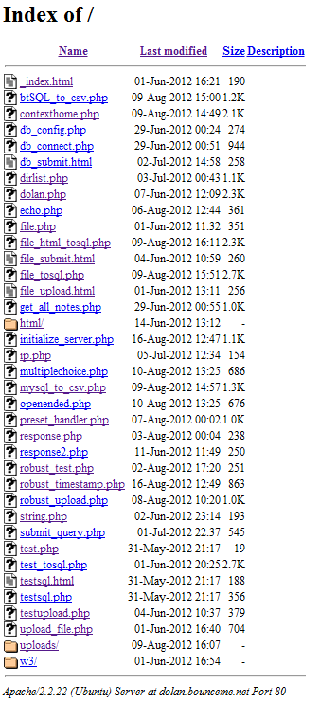


Data Server - Scalability
Replication (simple)
  Default LAMP install
  Include our php scripts
  Initialize

Slide 8

Archival Resolution
Queries data server to determine membership
App determined (may or may not result in an addition/removal from GCRS)

Slide 9
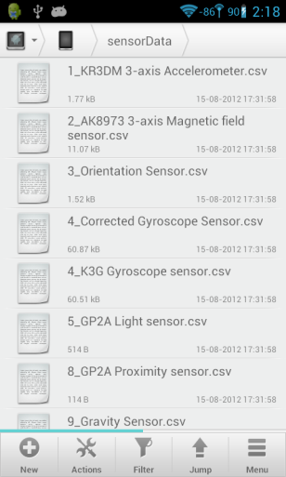
Immediate Resolution
Uses immediate data pull to determine membership
Client reads app’s def file
Client adds/removes itself

Slide 10


Abstraction for Apps
Combine base contexts
  Create new (app specific) context
  GCRS assigns group GUID
Apps needs only to communicate with group GUID for messaging
U4BZ7EFBXF6W173817483778HE1R05327BD55923

Slide 11
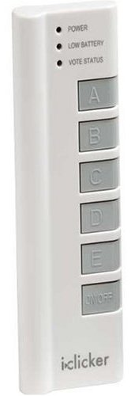
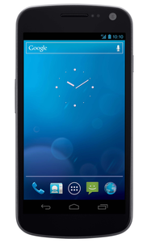
Prevailing App Idea
‘iClicker’
  Address truthful attendance issue
  Novel context reliant features

Slide 12
Smartphone (Indoor) Localization
[mini digression]

Slide 13
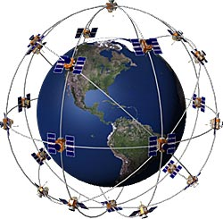


Smartphone (Indoor) Localization
GPS
  Unreliable indoors
Wifi trilateration/SVM
  Requires multiple WLAN
Bluetooth
  Self sufficient for dense networks
  For all phones
    Set discoverable
    Discover
    Send results (MAC & RSSI) to server to compute

Slide 14

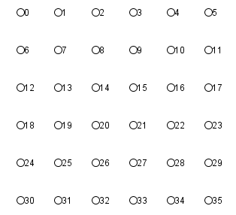
Algorithm Test with Generated Grid
Localization Algorithm
Grid truths
[Modified Algorithm via Robust Distributed Network Localization with Noisy Range Measurements, David Moore, John Leonard, Daniela Rus, Seth Teller MIT Computer Science and Artificial Intelligence Laboratory; 2004]

Slide 16
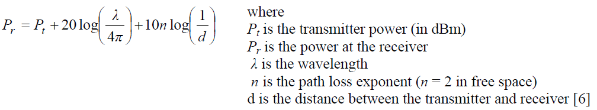
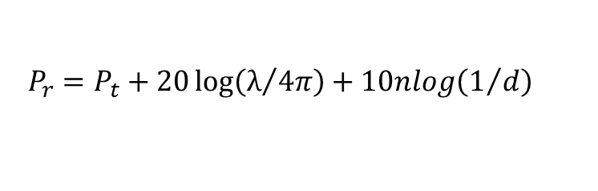
RSSI -> Distance
[Formula via Indoor Location Using Trilateration Characteristics, B Cook, G Buckberry, I Scowcroft, J Mitchell, T Allen, 2005 ]
$$P_{r}=P_{t}+20\log\left(λ/{4π}\right)+10nlog\left(1/d\right)$$

Slide 17
Anchor Points
One globally positioned -> all globally positioned
Wifi localization can resolve ambiguities

Slide 18
?

